Slide 1
Implementing PPACA: A Strategic Guide for Businesses
Presented by:
Steven J. Roy Benefits Management Advisors, LLC. Cell: 818-489-4228 Fax: 818-232-9178 sr@ccsrinc.com
Nastaran Motiei
ING Financial Partners
Ph: (310) 904-4692
Fx: 424-777-0751
Nastaran.motiei@ingfp.com
“Securities and investment advisory services offered through ING Financial Partners” Steven J Roy Steven J Roy Management, Inc, and Benefits Management Advisors, LLC are not affiliated with ING Financial Partners Neither ING Financial Partners or ING representative provide Tax or legal advice. Please consult with your tax or legal advisor regarding your individual situation.
IRS Circular 230 Disclosure: In order to comply with requirements imposed by the Internal Revenue Service, we inform you that any U.S. tax advice contained in this communication (including any attachments) is not intended to be used, and cannot be used, for the purpose of (i) avoiding penalties under the Internal Revenue Code or (ii) promoting, marketing, or recommending to another party any transaction or matter addressed herein.

Slide 2
Implementing PPACA – A Strategic Guide
PPACA, the Patient Protection and Affordable Care Act, like ERISA, Medicare, and Medicaid before it, is a game changer.
When fully implemented PPACA will alter your company’s budgeting, planning, pricing, hiring-firing, corporate culture assumptions, work scheduling, payroll reporting, benefits planning, accounting and tax compliance efforts.
Those changes will require adjustments to Human Resources (HR), Information Technology (IT), Accounting, Treasury/Controllership, and Administration.
Steven J. Roy Benefits Management Advisors, LLC Cell: 818-489-4228 Fax: 818-232-9178 sr@ccsrinc.com

Slide 3
A 30,000 Foot View of PPACA
PPACA fundamentally alters the way Americans buy health care. It introduces several ideas and approaches that are alien to our health care experience.
PPACA, with all its flaws and difficulties is probably here to stay.
PPACA is a moving target.
PPACA is a highly complex piece of legislation, enacted into an evolving operational and enforcement framework, by bureaucrats who (by and large) do not have to cope with its consequences.
Nearly every provision and interpretation of the Act is subject to change.
Steven J. Roy Benefits Management Advisors, LLC Cell: 818-489-4228 Fax: 818-232-9178 sr@ccsrinc.com

Slide 4
PPACA – Overview, Insurers’ & Business’ Responsibilities
Insurers
Must provide products that meet regulatory requirements
Secure an enlarged customer base and access to exchange markets
Businesses; Depending on size (number of FTE employees)
Must (or may) provide coverage that meets regulatory requirements
May face reporting, compliance, and procedural requirements, and
May receive tax credits or
May be penalized for failure to provide coverage.
Steven J. Roy Benefits Management Advisors, LLC Cell: 818-489-4228 Fax: 818-232-9178 sr@ccsrinc.com

Slide 5
PPACA’s Goldilocks Principle
The Fundamental Counting Algorithm: Determine FTE Employee Count
Company Size Determines Opportunities & Responsibilities
≤ 25 FTE, Eligible for Tax Credits if Providing Coverage
26-50 FTE, Not Eligible For Credits, Not Subject to Penalties
≥ 50 FTE, Provide coverage or pay penalties (Pay or Play)
50-250 FTE, Additional Reporting Requirements Apply
≥ 251 FTE, All Employer & Reporting Rules Apply (No Exceptions)
One Odd Wrinkle: The Counting Algorithm Differs Depending on Context
Steven J. Roy Benefits Management Advisors, LLC Cell: 818-489-4228 Fax: 818-232-9178 sr@ccsrinc.com

Slide 6
If The Business Mandate Applies (Pay or Play)
Which Employees Must Be Covered
Employees working 30 or more works per week
Coverage must commence no later than 90 days after hire
Large employers must use automatic enrollment
Coverage must not discriminate in favor of highly compensated employees
Employer may offer spousal and must offer dependent coverage (employer & employee expense)
What if They Aren’t Covered
Small Employers (<50 FTE) are not subject to penalty
Large Employers may be subject to either
No Coverage Penalty ($2,000 per employee), or
Inadequate Coverage Penalty ($3,000 per employee)
Adequacy of coverage is determined by:
Affordability
Actuarial Coverage
Steven J. Roy Benefits Management Advisors, LLC Cell: 818-489-4228 Fax: 818-232-9178 sr@ccsrinc.com

Slide 7
PPACA Coping Strategies Mitigating or Avoiding PPACA’s Impacts
Our discussion up to this point suggests there are at least six fundamental approaches to coping with, mitigating, or avoiding PPACA’s impacts.
Companies can mix and match among:
Refuseniki (Pay, Don’t Play)
Company Size Management
Labor Force Hours Management
Benefit Coverage Management
Benefit Cost Management
Pro-Active or Productivity Management
Steven J. Roy Benefits Management Advisors, LLC Cell: 818-489-4228 Fax: 818-232-9178 sr@ccsrinc.com

Slide 8
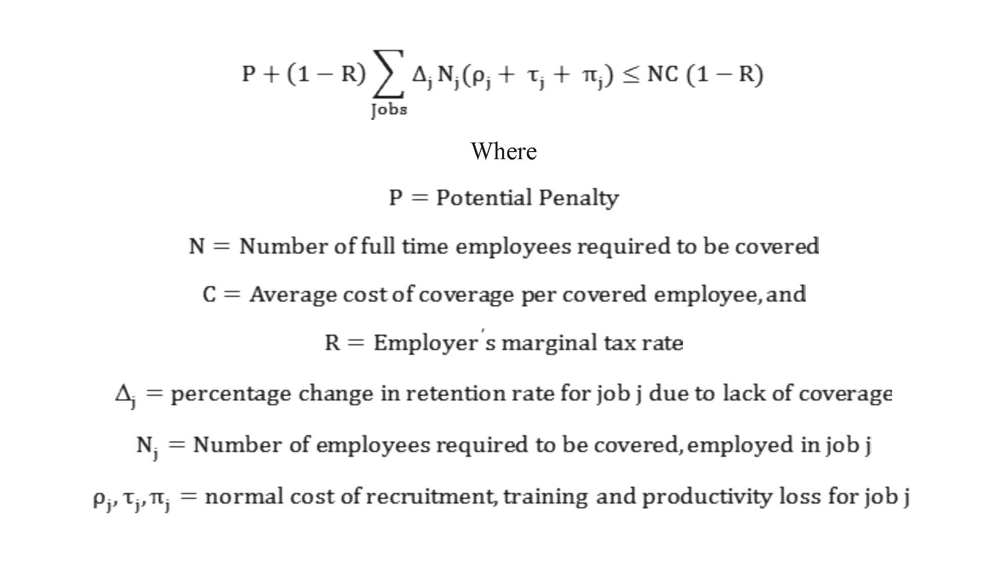
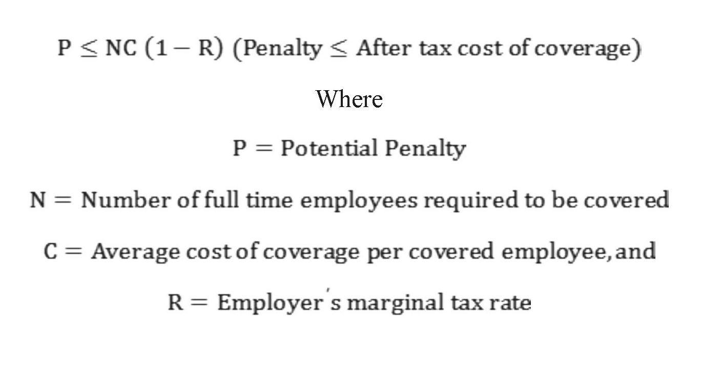
Refuseniki Strategy: Pay, Don’t Play For Large Companies Viability Depends on Labor Market Conditions, Not Relative Costs of Penalty & Coverage!
In Highly Competitive Labor Markets
In Non-Competitive Labor Markets
Steven J. Roy Benefits Management Advisors, LLC Cell: 818-489-4228 Fax: 818-232-9178 sr@ccsrinc.com

Slide 9
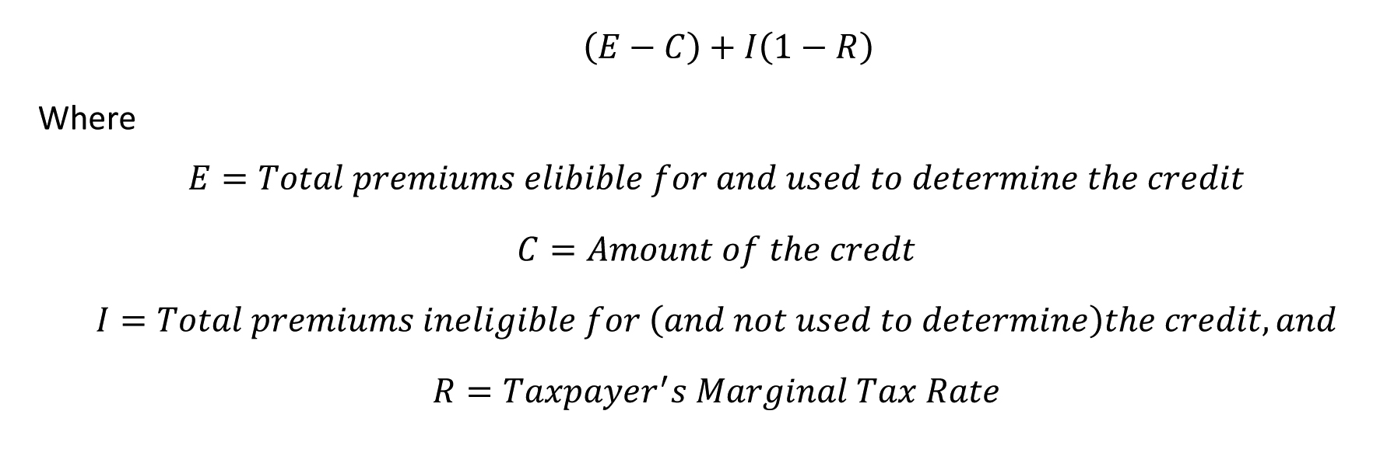
Refuseniki Strategy: Play or Don’t Play For Small Companies Decision Often Depends on After Tax Cost Of Coverage & General State of Employee Relations
Availability of the credit for small employer coverage- ● Pay premiums for health insurance under a qualifying arrangement ● 25 or fewer FTE Employees (2080 hours per year) ● Average annual wages < $50000 per FTE Credit = 35% (50% after 1/1/2014) of cost of coverage After tax cost of coverage
Steven J. Roy Benefits Management Advisors, LLC Cell: 818-489-4228 Fax: 818-232-9178 sr@ccsrinc.com

Slide 10
Company Size Management Strategy Viability Determined By Company Growth Plan & Task Divisibility
For Companies on the Cusp:
Slow or no growth of employment base
Task consolidation to avoid use of part time employees
Outsourcing
One Strategy that is probably a Non-Starter:
Recent regulations invoke IRC §§318, 414 so splitting up the company into several smaller ones will only work if current owners are willing to shed control.
Another Should Be Used With Caution;
Shedding employees, who then become “independent contractors” can be far more trouble than it is worth.
None of these approaches is viable in a growing, dynamic environment.
Steven J. Roy Benefits Management Advisors, LLC Cell: 818-489-4228 Fax: 818-232-9178 sr@ccsrinc.com

Slide 11
Labor Force Hours Management Strategy Most Viable with Relatively Unskilled Labor Force & Highly Divisible Tasks
Reduce labor performing highly divisible tasks.
Task Consolidation and Reassignment
Out-Sourcing and Independent Contractors
Two issues to beware of:
ERISA §510
Shedding employees, who then become “independent contractors” can be far more trouble than it is worth.
These approaches affect worker loyalty, efficiency, and productivity.
Ironically, they may not be usable in several very low skill environments.
Steven J. Roy Benefits Management Advisors, LLC Cell: 818-489-4228 Fax: 818-232-9178 sr@ccsrinc.com

Slide 12
Benefit Coverage Management Strategy Most Viable with Relatively Unskilled Labor Force & Highly Divisible Tasks
Reduce the covered population.
The Refuseniki Strategy
Reduce Employee work hours in divisible, low-skill tasks to ≤ 30/week.
Shed or displace previously covered populations (spouses who have access to other coverage)
Prospective changes to retiree benefits
Examples of this approach:
UPS – Denied coverage to spouses who have access through their own employers.
IBM – reoriented retiree benefits.
Steven J. Roy Benefits Management Advisors, LLC Cell: 818-489-4228 Fax: 818-232-9178 sr@ccsrinc.com

Slide 13
Cost Management Strategy Mid and Long Term Cost Considerations and Trends
Long and Mid-Term Drivers of Health Care Cost
Employer/Employee Driven Strategies
Greater employee accountability (higher deductible & co-pay, higher premium participation)
Eroding coverage of retiree medical benefits (new employees)
More ABHPs (both for cost reduction and in anticipation of the Cadillac tax.)
Greater employer investment in preventative care
More reliance on emerging technologies (telemedicine, mobile apps, e-visits, data-enabled kiosks)
Emphasis on performance based provider reimbursements
Steven J. Roy Benefits Management Advisors, LLC Cell: 818-489-4228 Fax: 818-232-9178 sr@ccsrinc.com

Slide 14
Cost Management Strategy Mid and Long Term Cost Considerations and Trends
Long and Mid-Term Drivers of Health Care Cost
Employer/Provider Focused Strategies
Vendor/Provider payments based on achievement of specific performance targets
Incentives (or penalties) to providers to improve quality, efficiency and health outcomes of plan participants (i.e., performance-based payments)
Use of a third party negotiator to secure improved pricing for medical services
Incentives (or penalties) to providers for coordinating care and using emerging technologies or evidence-based treatments
New payment methodologies that hold providers accountable for cost of episode of care, replacing fee for service
Contract directly with physicians, hospitals and/or ACOs
Steven J. Roy Benefits Management Advisors, LLC Cell: 818-489-4228 Fax: 818-232-9178 sr@ccsrinc.com

Slide 15
Cost Management Strategy Mid and Long Term Cost Considerations and Trends
Long and Mid-Term Drivers of Health Care Cost
Market Factors
Two steps forward:
Movement away from service delivery in high cost environments toward lower cost environments (HMO → PPO, Hospital/ER → Clinic )
Federal readmission penalties (Medicare and Medicaid)
Three steps back:
Switch to biologics (away from generics)
Health industry consolidation
Doctor shortage
Steven J. Roy Benefits Management Advisors, LLC Cell: 818-489-4228 Fax: 818-232-9178 sr@ccsrinc.com

Slide 16
Cost Management Strategy PPACA’s Built-In Cost Containment “Incentive” - The Cadillac Tax
After 12/31/2017, ACA imposes a 40% excise tax on plans whose value exceeds $10,200/year for individual coverage and $27,500/year for family coverage.
Many plans already approach or exceed this threshold and corporate cultural changes may take time to take hold:
Start the negotiation and acculturation processes now!
Steven J. Roy Benefits Management Advisors, LLC Cell: 818-489-4228 Fax: 818-232-9178 sr@ccsrinc.com

Slide 17
Cost Management Strategy PPACA Limits Cost Shedding via “Employee Accountability” The 60% Actuarial Rule
Large employer plans must surpass two actuarial thresholds to be considered “adequate.” The plan must cover:
100% of the cost of “essential health benefits,” and
At least 60% of the actuarial value of all covered services
Practical Implication #1: There is a limit to how much employee accountability and cost shifting can be incorporated into a plan. Use of high deductibles or copays, cost-sharing scenarios, employee shared-cost wellness programs or shared-cost on-site clinics may tip the balance of your plan from “adequate” to “inadequate.”
Practical Implication #2: The more cost sharing or non-standard features included in your plan, the more likely you will need to retain an actuary or rely heavily on the plan designer/sponsors’ actuary and advisors to determine plan adequacy.
Steven J. Roy Benefits Management Advisors, LLC Cell: 818-489-4228 Fax: 818-232-9178 sr@ccsrinc.com

Slide 18
Proactive Employer Strategy General Trends
Employee Accountability
The Rise of ABHPs (Account Based Health Plans)
Private Exchanges
Cash-In-Lieu-Of Arrangements
Employee Wellness Programs
On-Site Clinics and Telemedicine
Process Redefinition & Lean Management
Steven J. Roy Benefits Management Advisors, LLC Cell: 818-489-4228 Fax: 818-232-9178 sr@ccsrinc.com

Slide 19
Proactive Employer Strategy Employee Accountability
Higher deductible & co-pay, higher premium participation)
Eroding coverage of retiree medical benefits (new employees)
More ABHPs
Greater employer investment in preventative care
More reliance on emerging technologies (telemedicine, mobile apps, e-visits, data-enabled kiosks)
Emphasis on performance based provider reimbursements
Steven J. Roy Benefits Management Advisors, LLC Cell: 818-489-4228 Fax: 818-232-9178 sr@ccsrinc.com

Slide 20
Proactive Employer Strategy Account Based Health Plans (ABHPs)
General Design Features of ABHPs
Health Savings Account (HSA)
Contribution Limits under PPACA
High Deductible Health Policy (HDHP)
Deductible Limit und PPACA
Health Savings Account Features
Contributions to the HSA not subject to federal income tax regardless of who makes the contribution.
Earnings of the trust accumulate tax free until they are distributed.
If funds are distributed to pay eligible medical expenses the distribution is tax free as well.
Accumulations in the fund rolled over from year to year until used, or until the employee deceases.
The HSA is the personal property of the employee. It is therefore “portable” if the employee leaves the employer.
Steven J. Roy Benefits Management Advisors, LLC Cell: 818-489-4228 Fax: 818-232-9178 sr@ccsrinc.com

Slide 21
Proactive Employer Strategy Account Based Health Plans (ABHPs)
The Dark Side of ABHPs:
Employees have been slow to adopt ABHPs. Among companies that offer ABHPs
Median enrollment is approximately 15%.
Less than half (46% in 2011) of the programs experience 20% enrollment.
Less than 10% of the programs are fully subscribed.
Those employees who have enrolled are not particularly thrilled with the results. When compared to enrollees in traditional plans ABHP enrollees express consistently lower levels of
satisfaction with both the plan and the services they receive under it, and
understanding of the plan’s provisions
Most seriously: Employees enrolled in ABHPs often have little or no understanding of the wealth accumulation features of the plan and/or their ability to plan for post-retirement medical needs using the plan.
Steven J. Roy Benefits Management Advisors, LLC Cell: 818-489-4228 Fax: 818-232-9178 sr@ccsrinc.com

Slide 22
Proactive Employer Strategy On-Site Clinics and Telemedicine
On-site Clinics Under PPACA
Coordination with ABHP, HSA, and HDHP provisions
Single plan restriction
Coordination with Internal Revenue Code §223
Coordination with 60% Rule
Coordination with Cadillac Tax
Collateral Administrative and Compliance Issues
Plan reporting under ERISA
Plan inclusion under COBRA (Security and Liability Issues)
HIPAA Compliance
Steven J. Roy Benefits Management Advisors, LLC Cell: 818-489-4228 Fax: 818-232-9178 sr@ccsrinc.com

Slide 23
PPACA’s Impact on Corporate Culture
The Rise (and Change) of the Team
Coordination of multiple departments in what was once the almost exclusive domain of HR.
Ascendance of the Finance Folk (CFO, Controller, Accounting, & Payroll)
Receding Role of HR and Benefits Management
IT plays a crucial role.
Diminishing value of health care as a retention device.
Possible influence of future tax changes.
Steven J. Roy Benefits Management Advisors, LLC Cell: 818-489-4228 Fax: 818-232-9178 sr@ccsrinc.com

Slide 24
More Information About Implementing PPACA
Primary Contact: Steven J. Roy Benefits Management Advisors, LLC.
Follow our Blog at: http://BenefitAdvisors.Biz
Cell: 818-489-4228 Fax: 818-232-9178 steven.roy@ccsrinc.com or on Facebook at https://www.facebook.com/steven.roy.5
Contact us or join us on LinkedIn’s Affordable Care Act Implementation Group
http://www.linkedin.com/groups/Affordable-Care-Act-Implementation-Group-5144677
IRS Circular 230 Disclosure: In order to comply with requirements imposed by the Internal Revenue Service, we inform you that any U.S. tax advice contained in this communication (including any attachments) is not intended to be used, and cannot be used, for the purpose of (i) avoiding penalties under the Internal Revenue Code or (ii) promoting, marketing, or recommending to another party any transaction or matter addressed herein.

